Slide 6
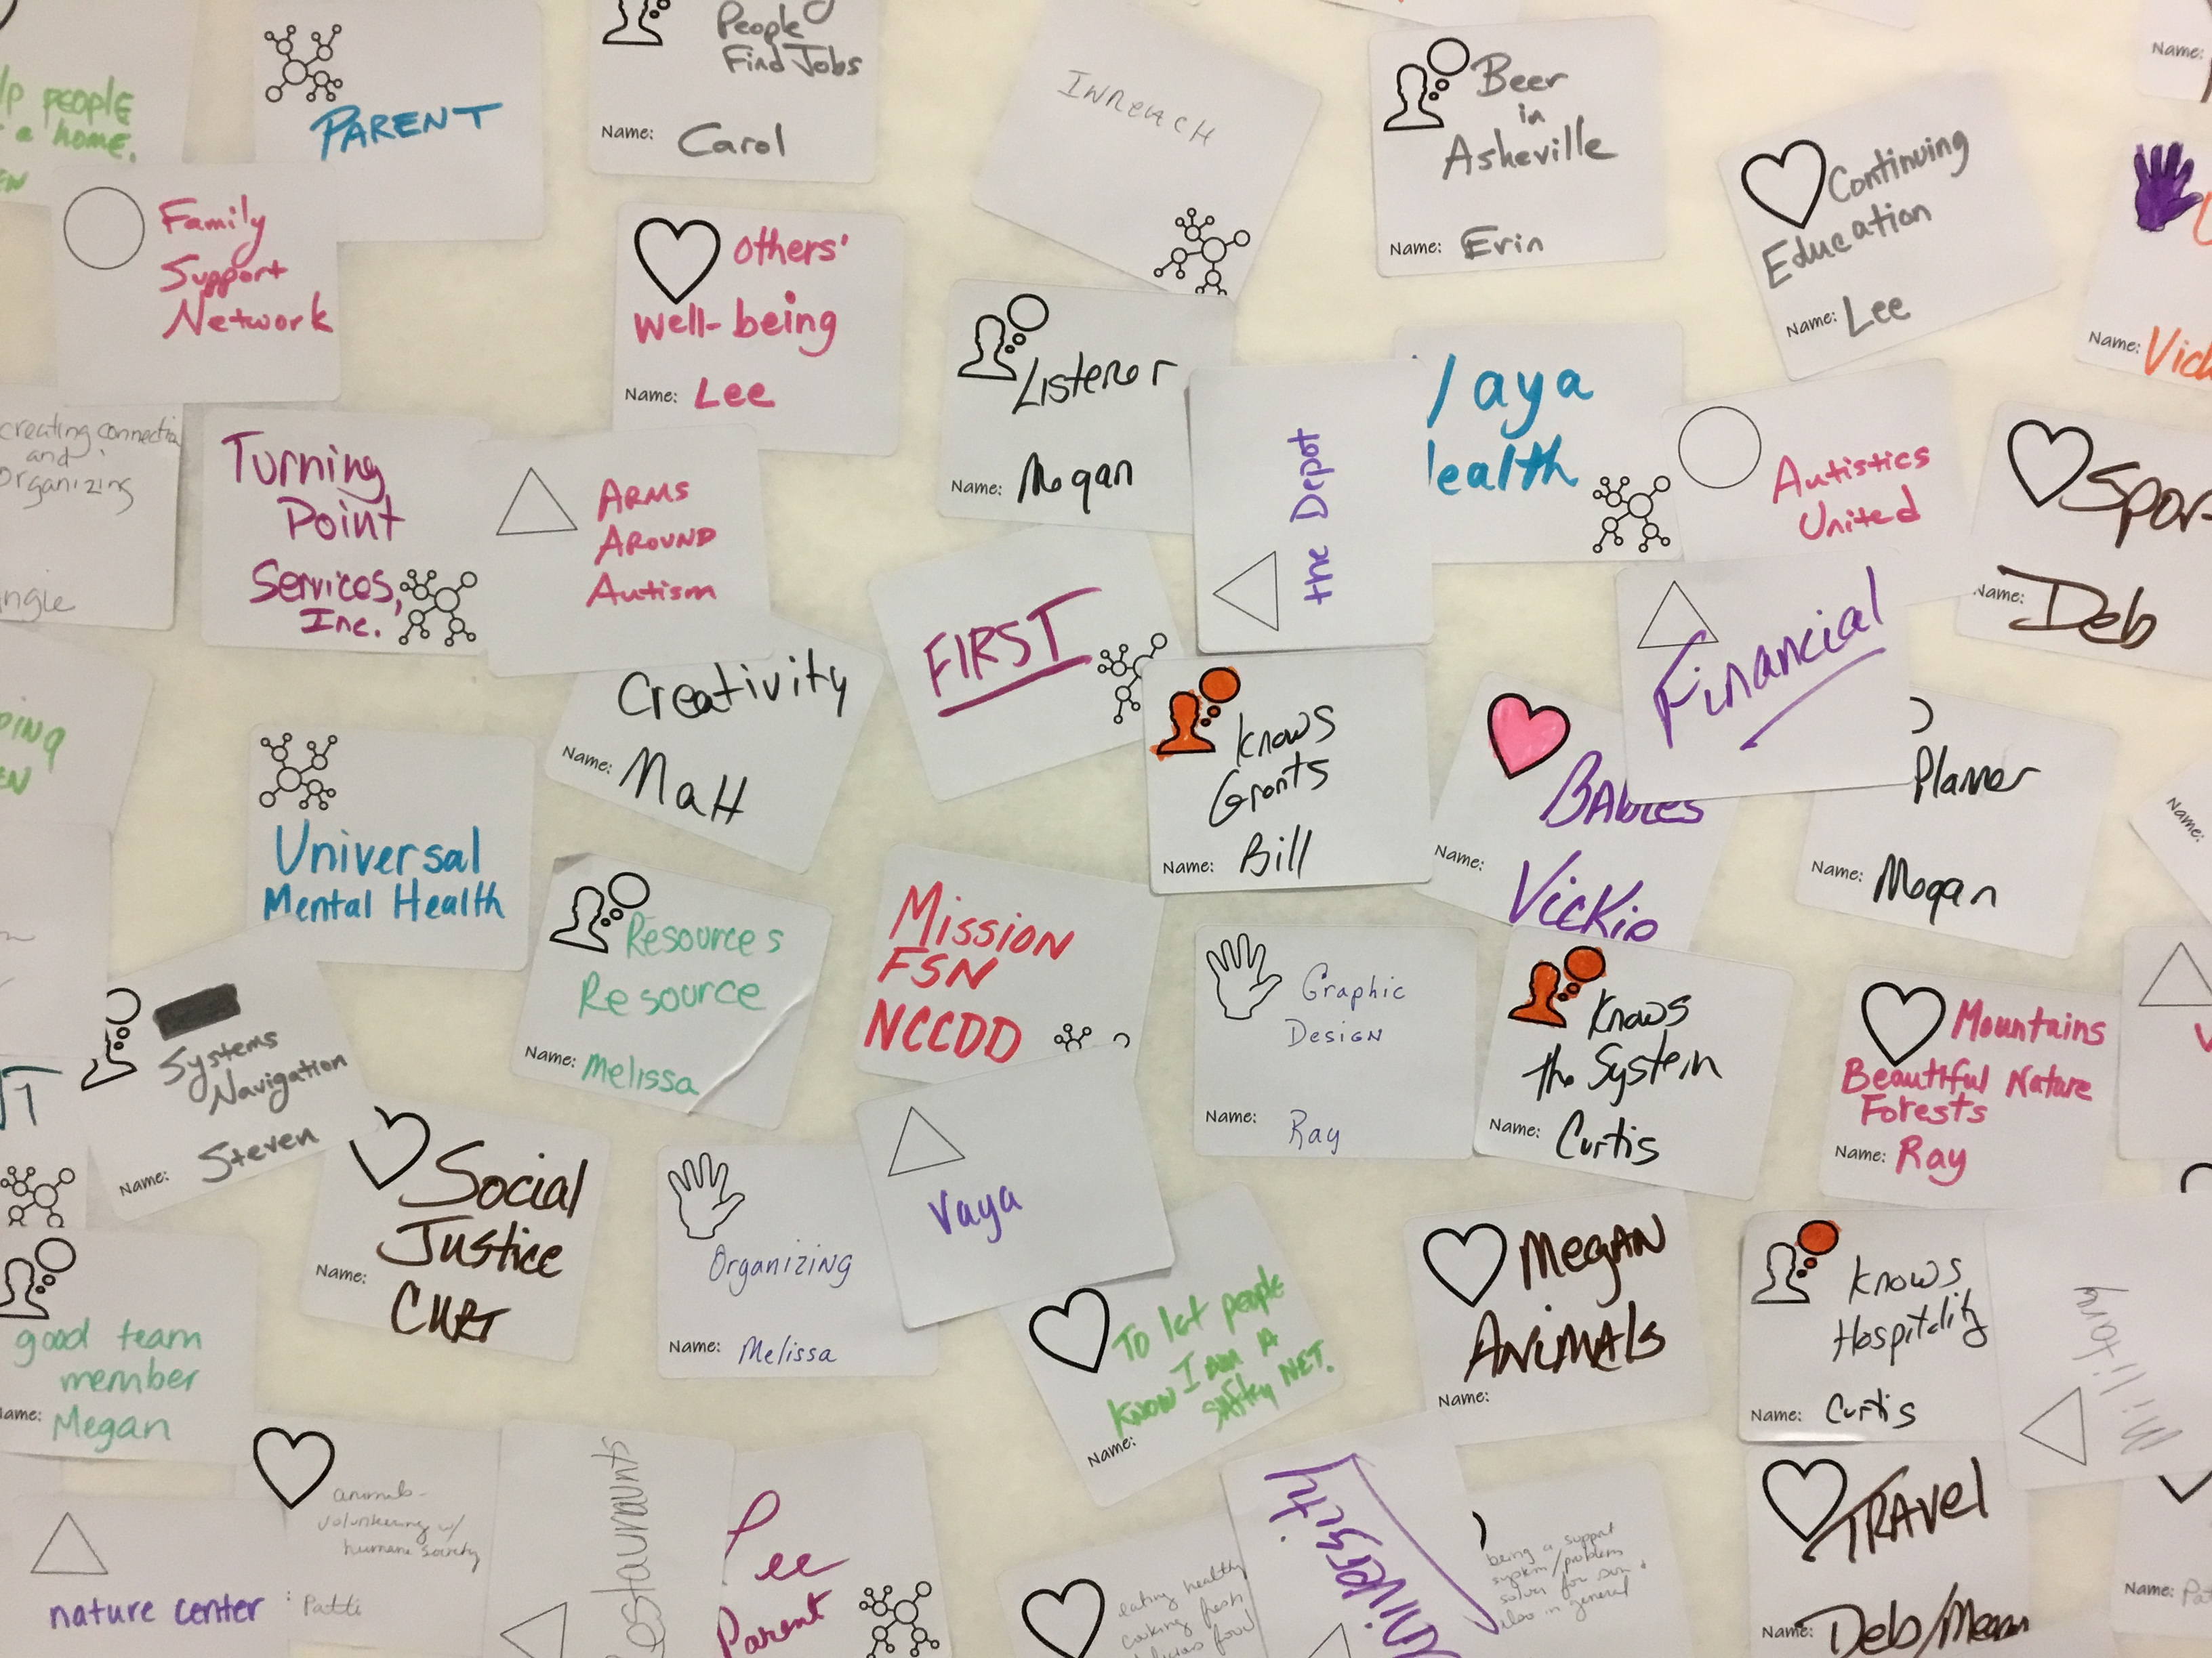
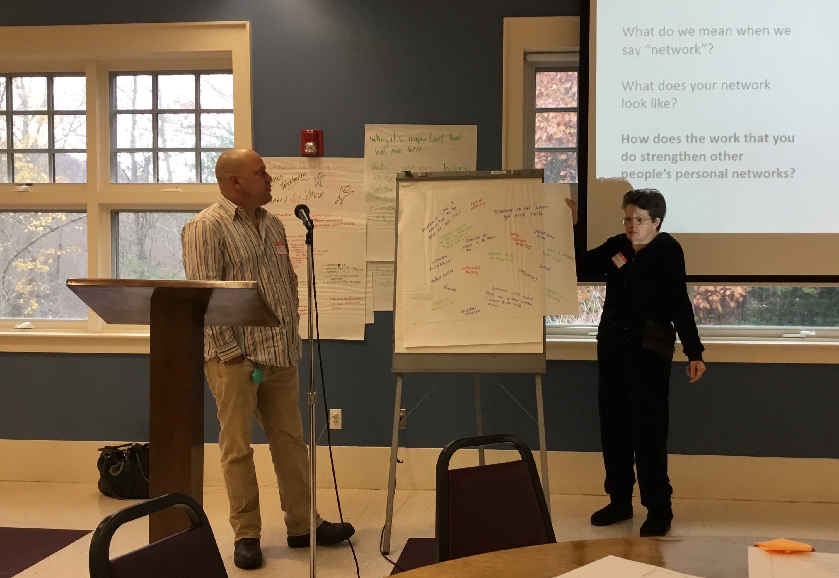
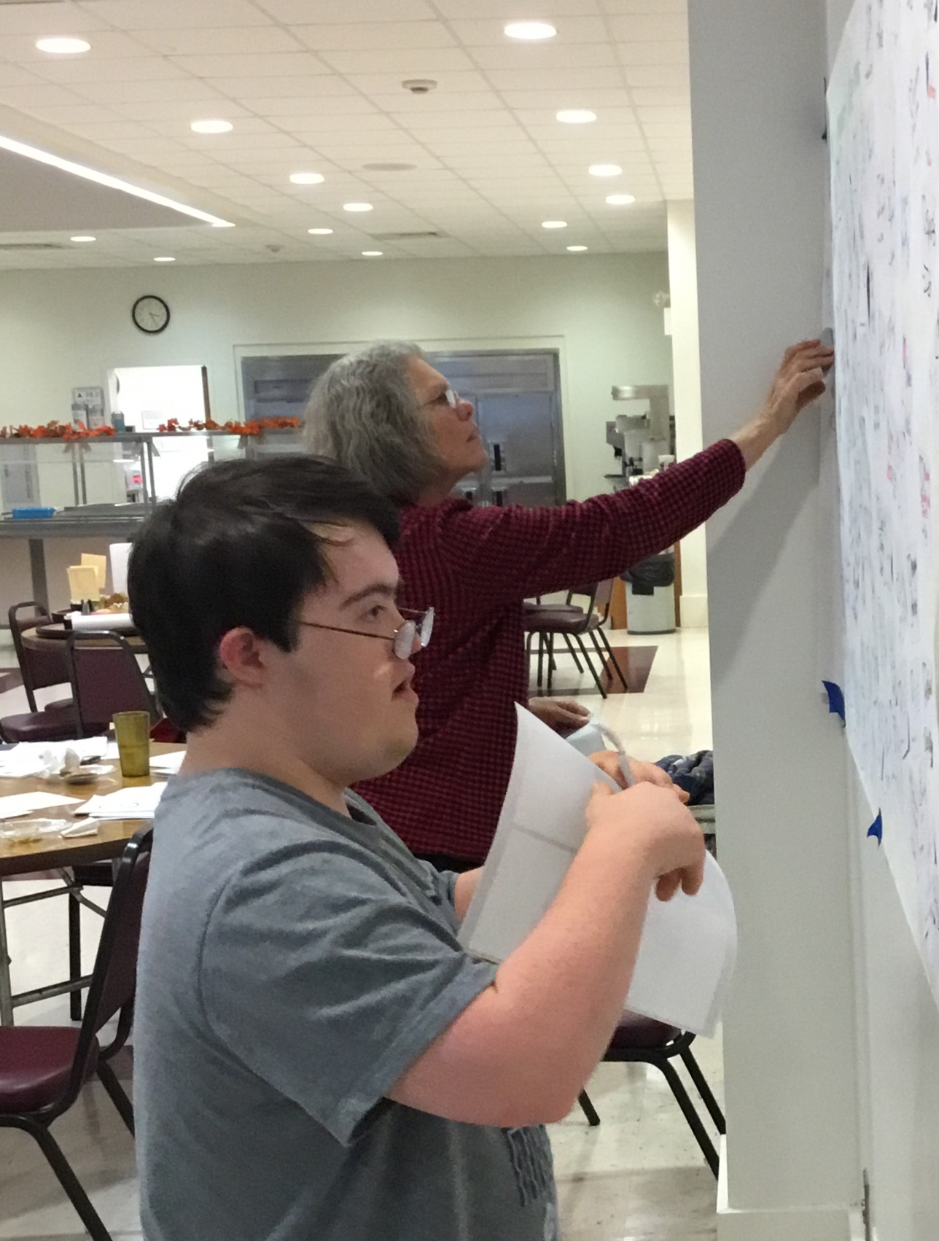
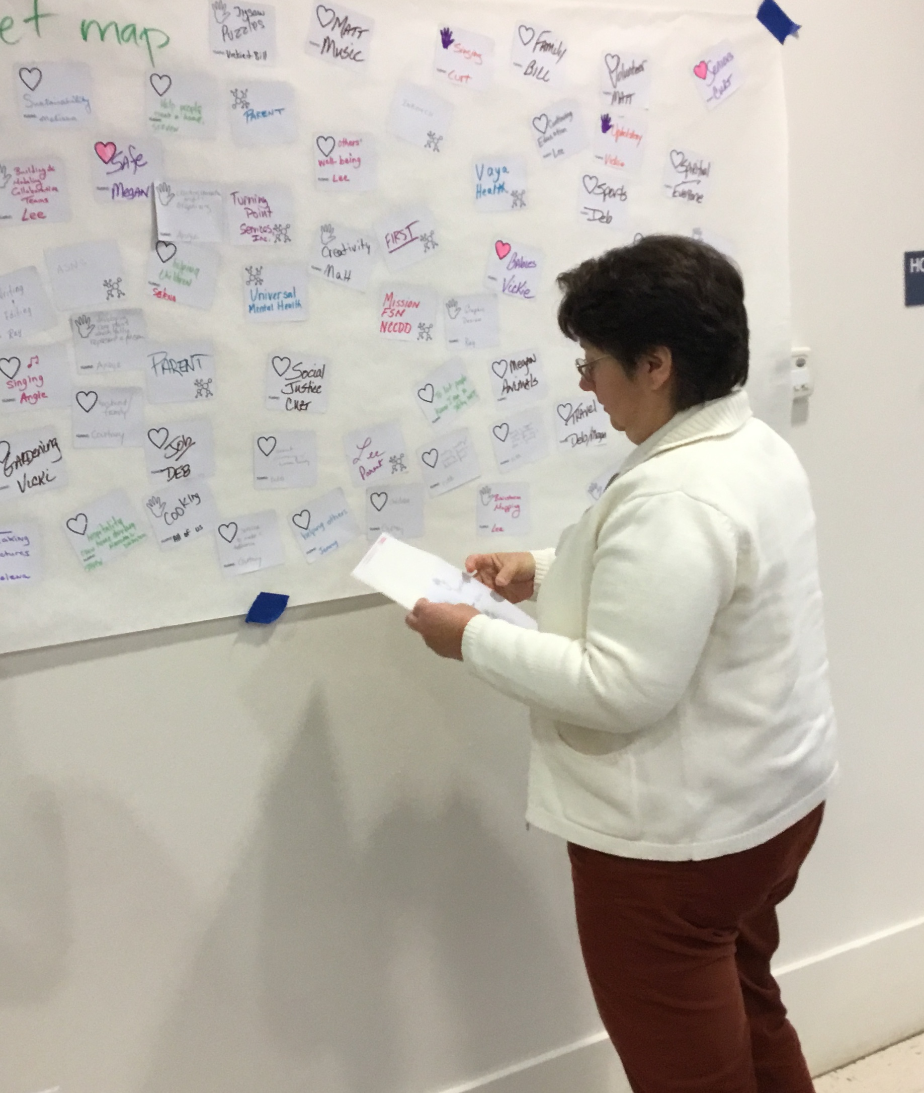
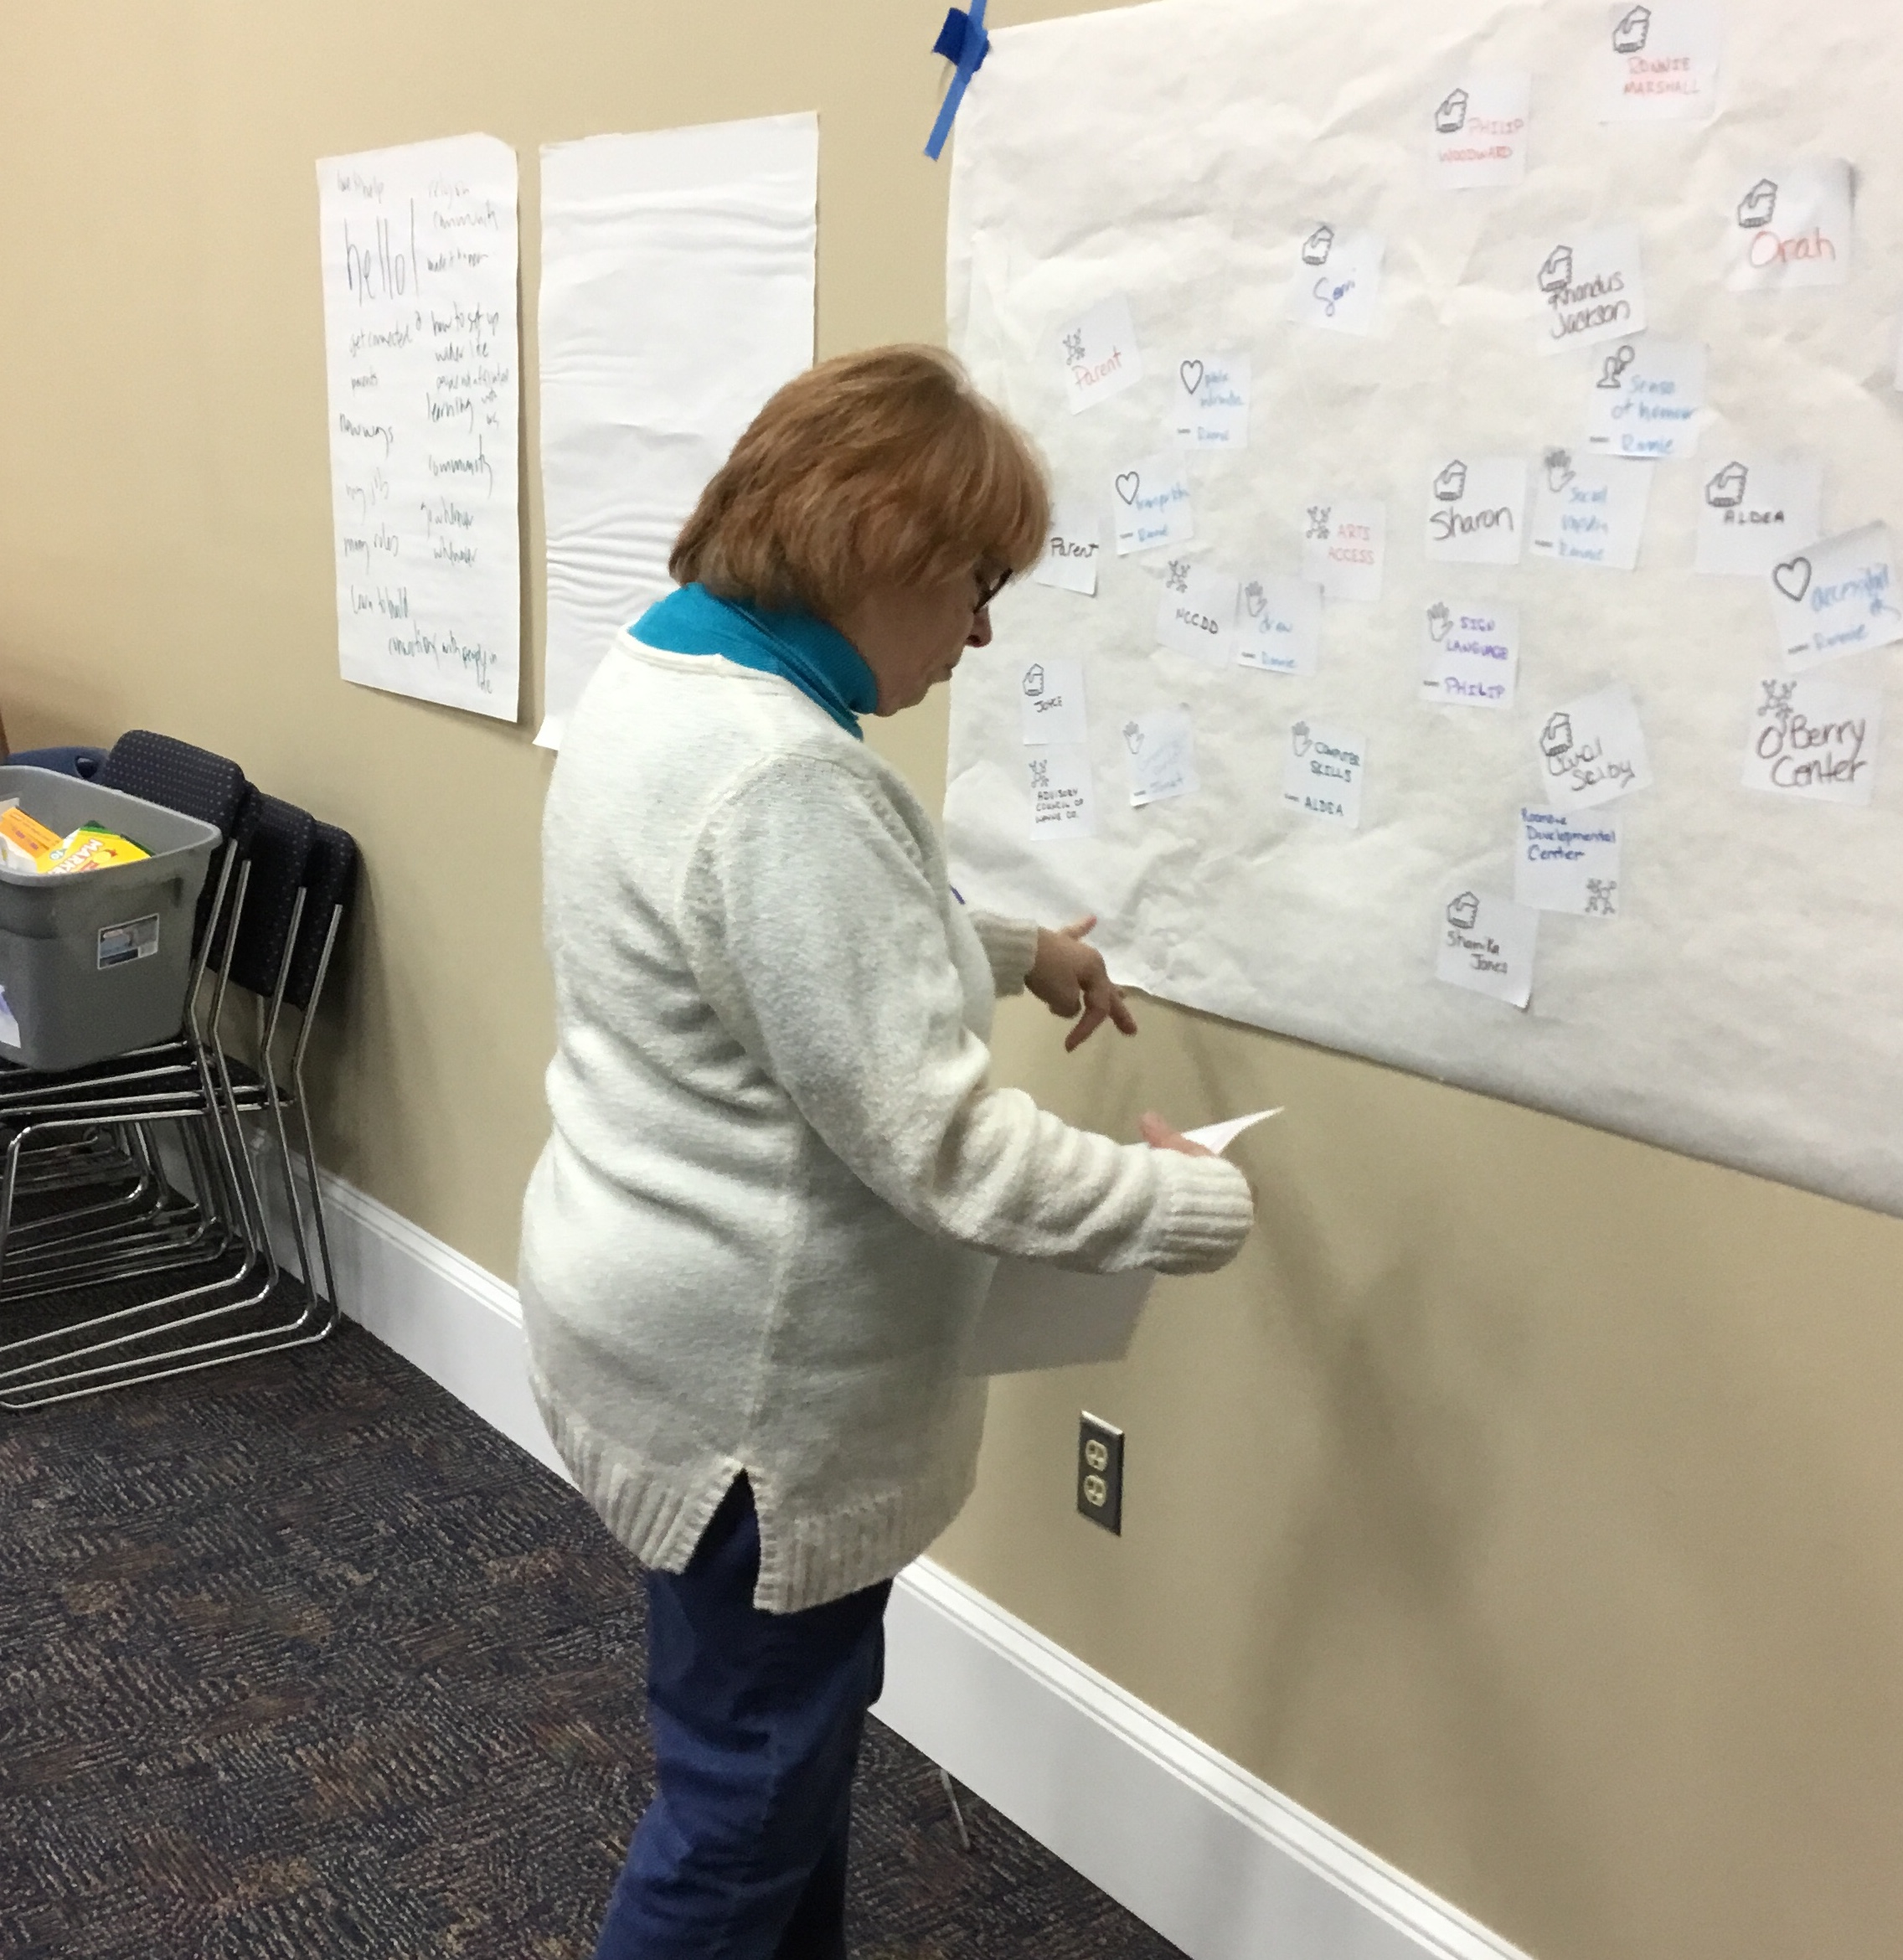

Slide 7
Initial Plan
Community Conversation to share ideas
25 professionals and 25 focus people sign up to get involved
Building Networks Workshop
Mobilizing Networks Workshop
Online Mentoring and Support
Tools and Resources

Slide 8
What we learned
Not effective to train 25 people from across the state at one time with one method
Changed our plan to become more individualized, smaller groups and broader impact

Slide 9
What we learned
Now 3 distinct Learning Communities:
- Families and Community
- Supported Living Team
- Horizons Center
We are also ensuring the the tools and resources are more available and accessible.

Slide 10
Some Data
36 persons attending the Community Conversations in Nov 2018
22 persons signed up for the online course
17 persons completed the course
23 personal networks teams are creating community
72 persons have received training about creating personal support networks
201 followers on Full Circe Facebook page,
33 new followers and 3,178 reach over last month

Slide 11
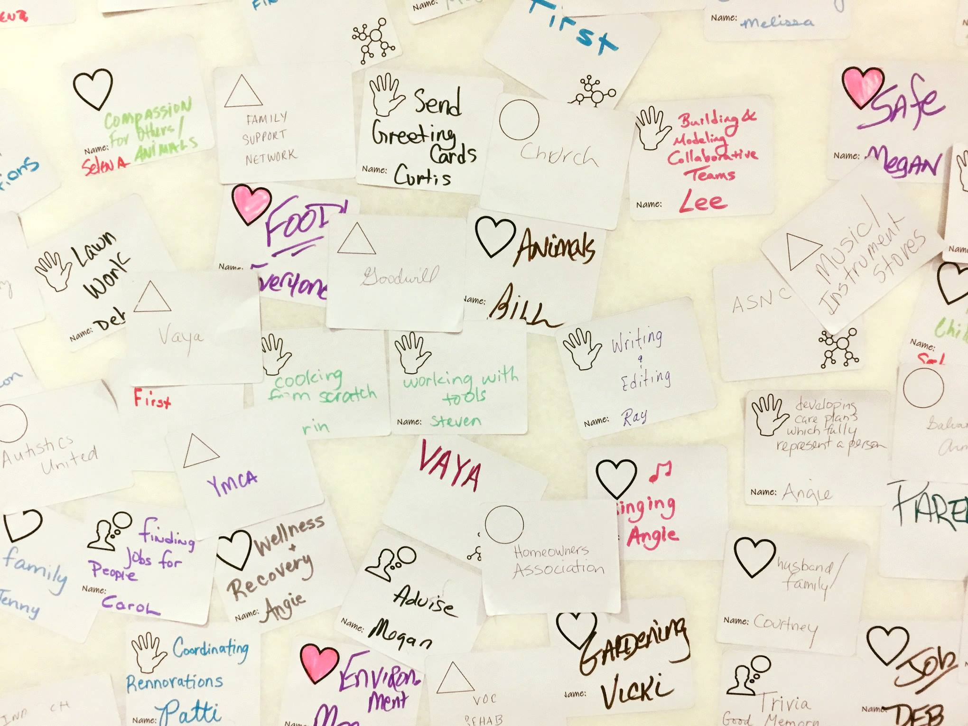
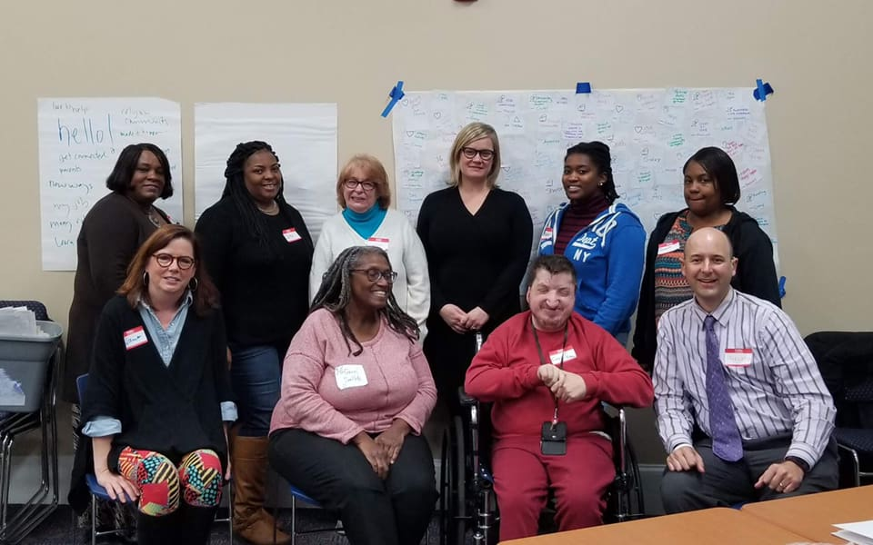
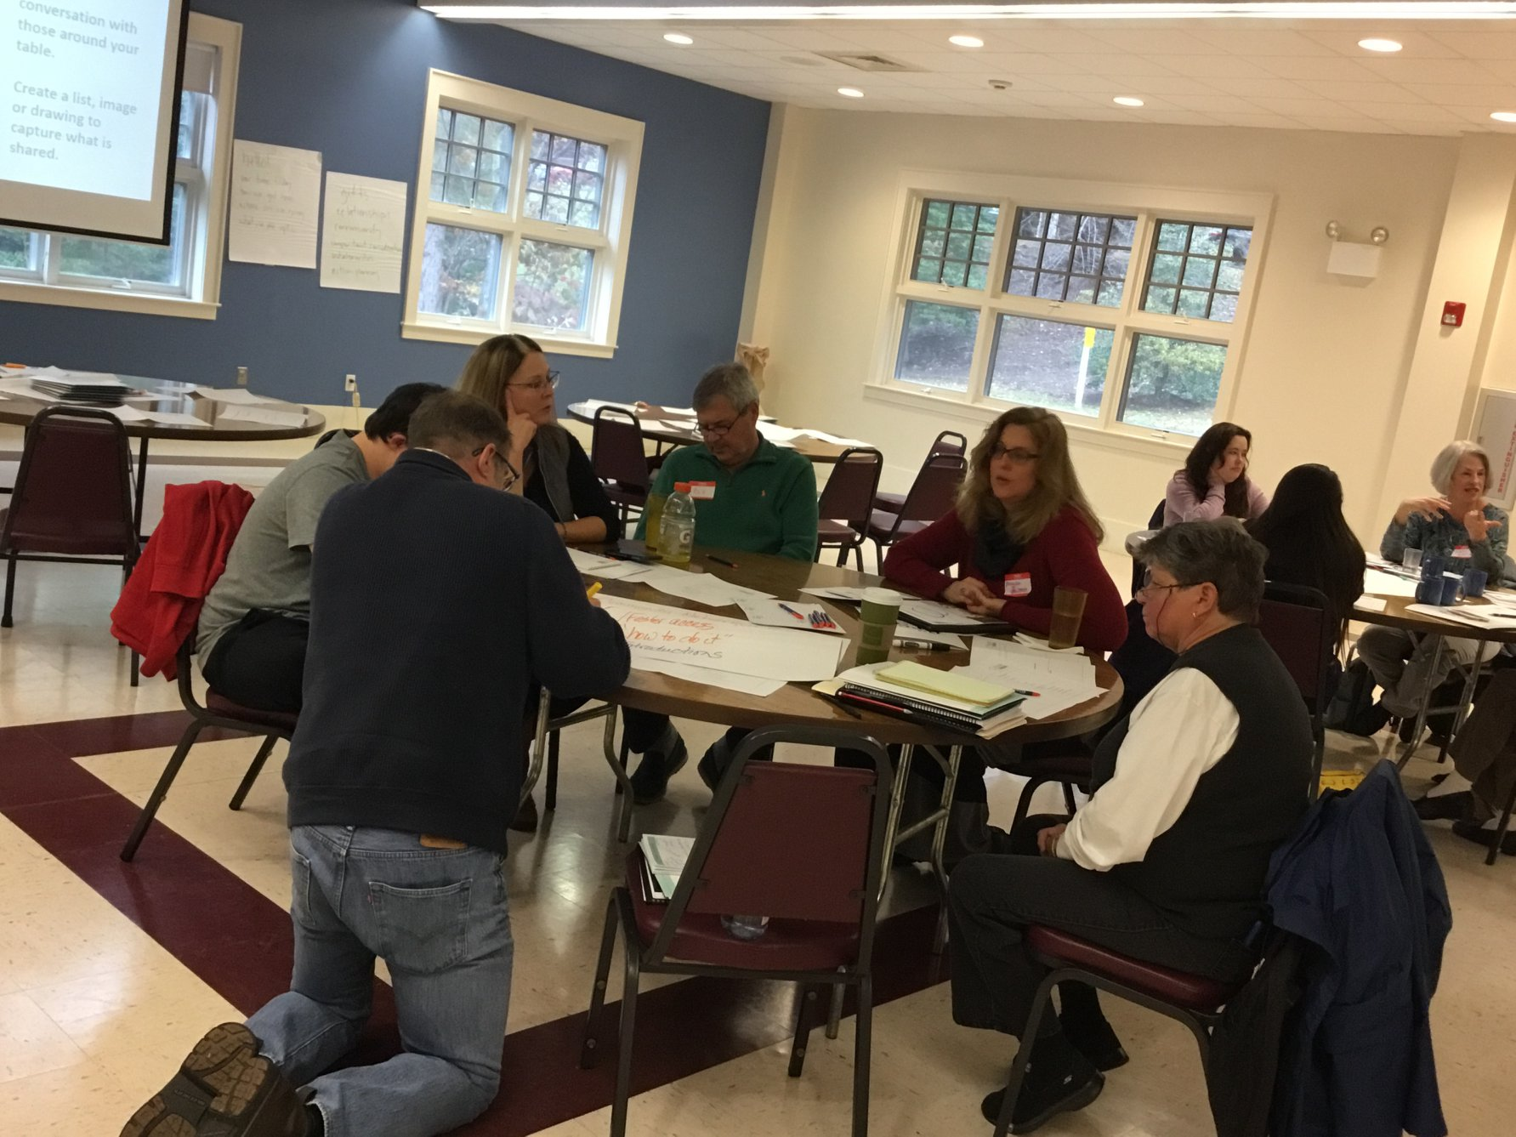
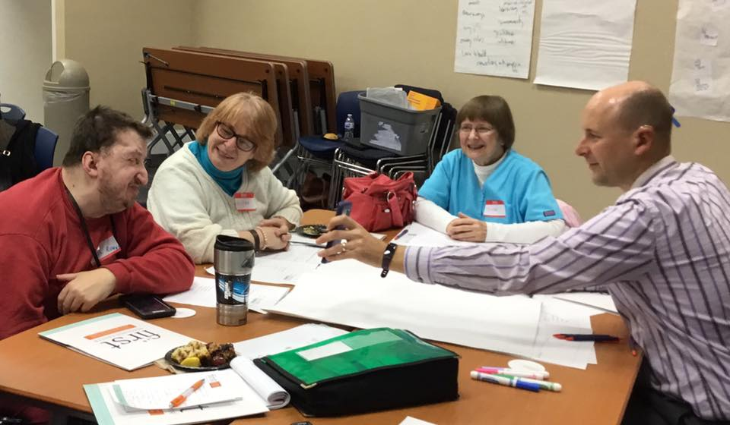
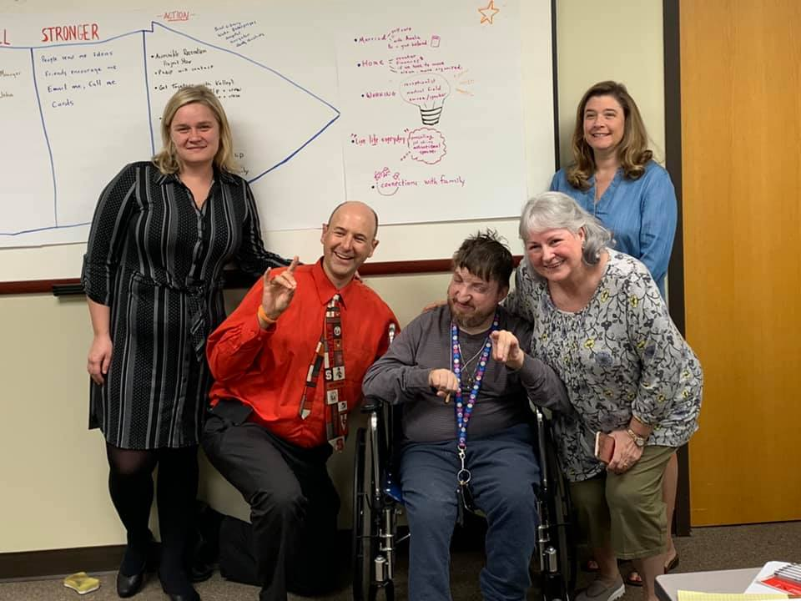
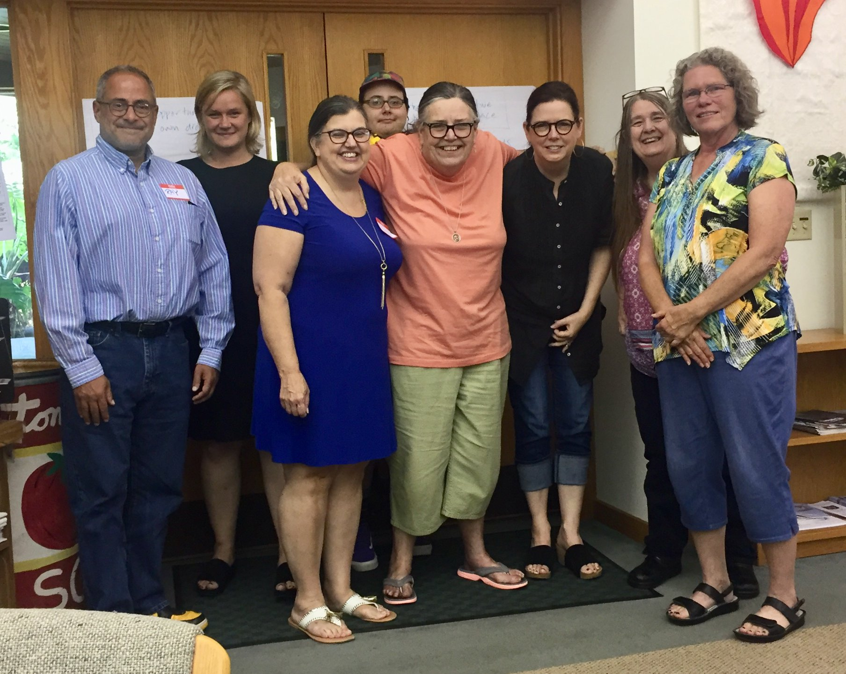
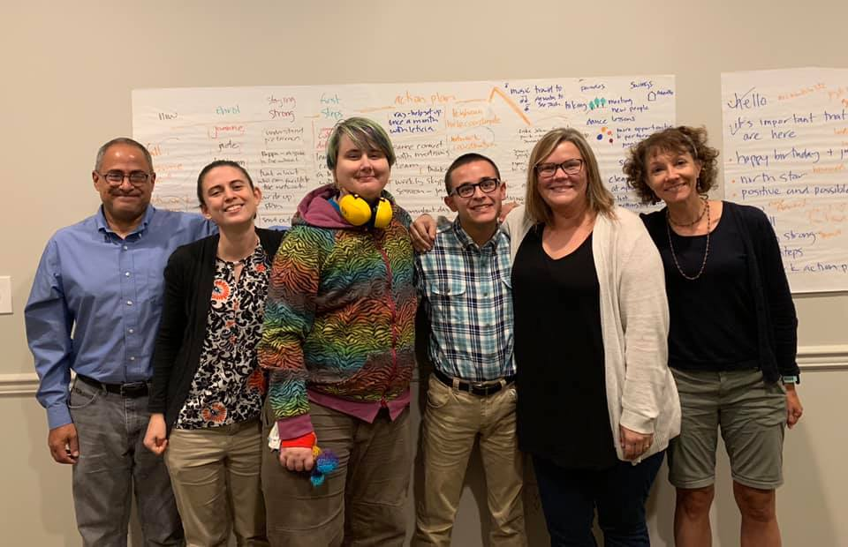
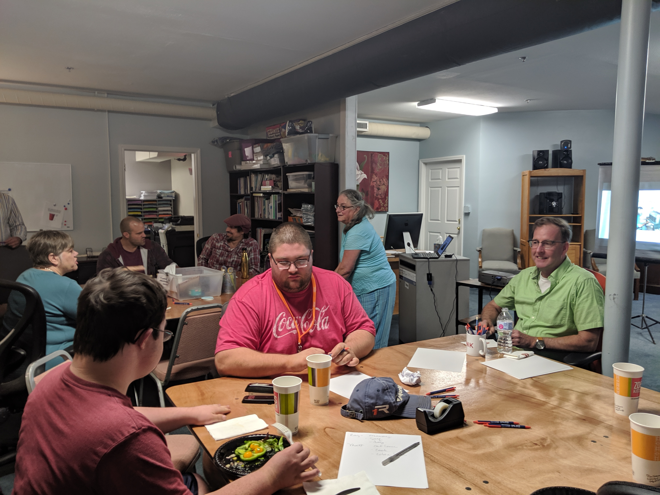

Slide 12
Community and Family Learning Group

Slide 13
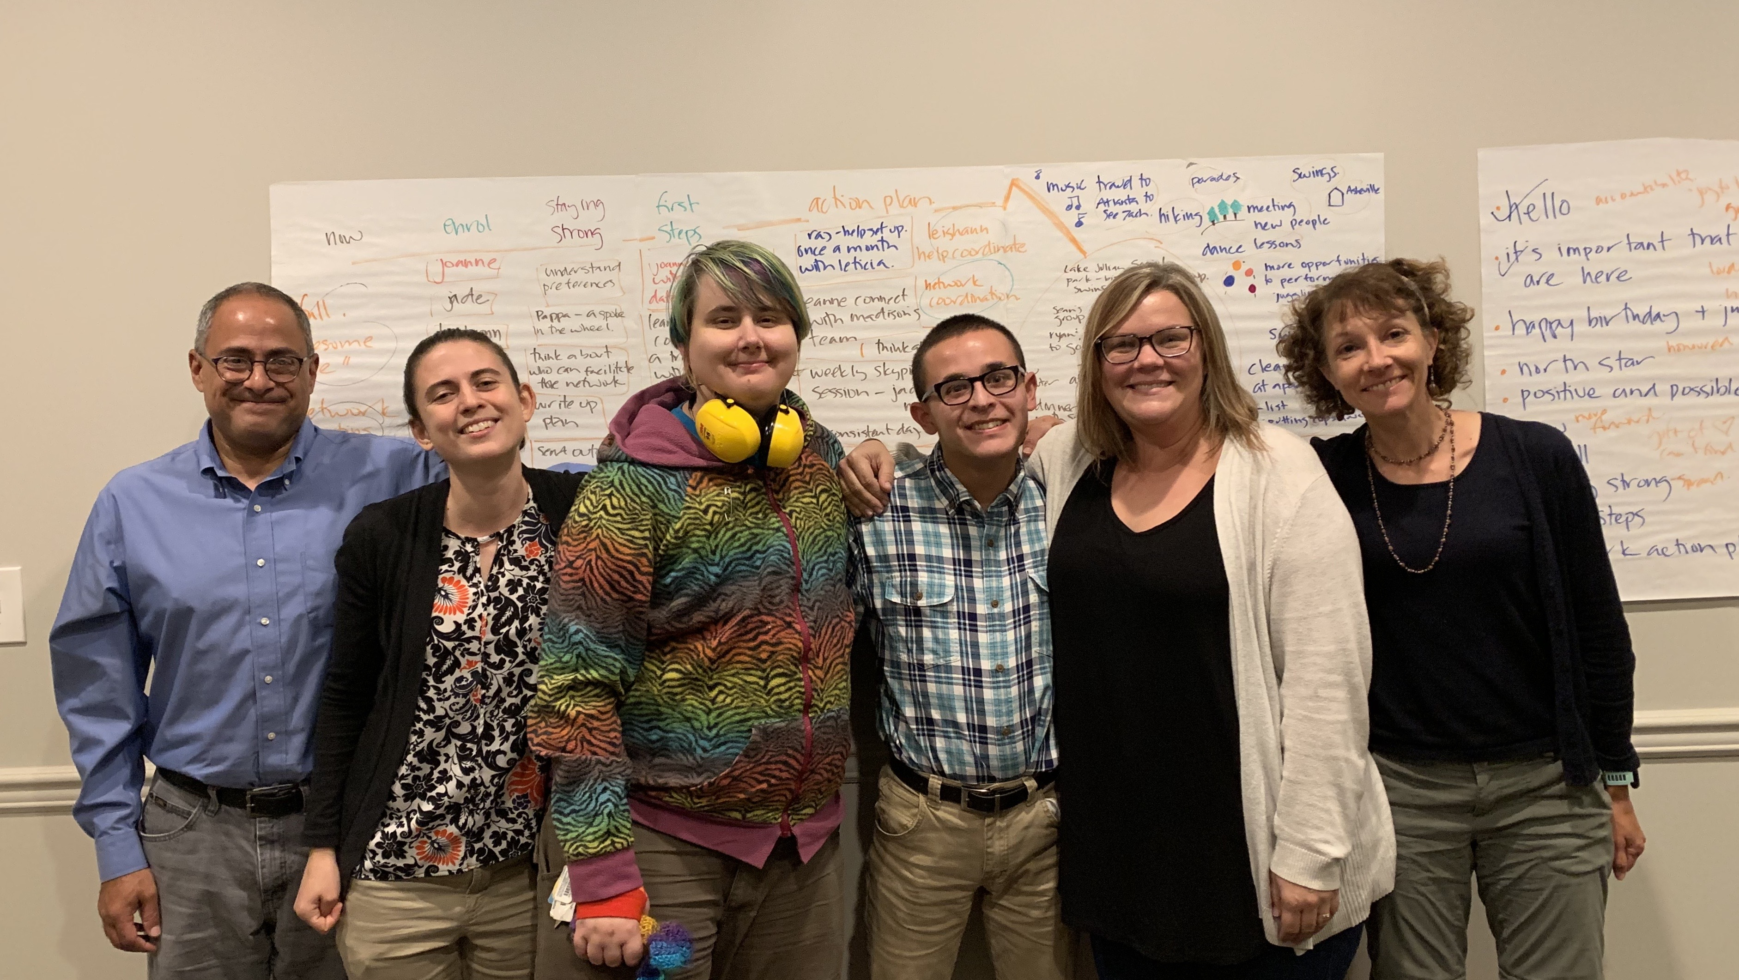
Nicholas’s New Network

Slide 14
Ronnie’s New Network

Slide 15
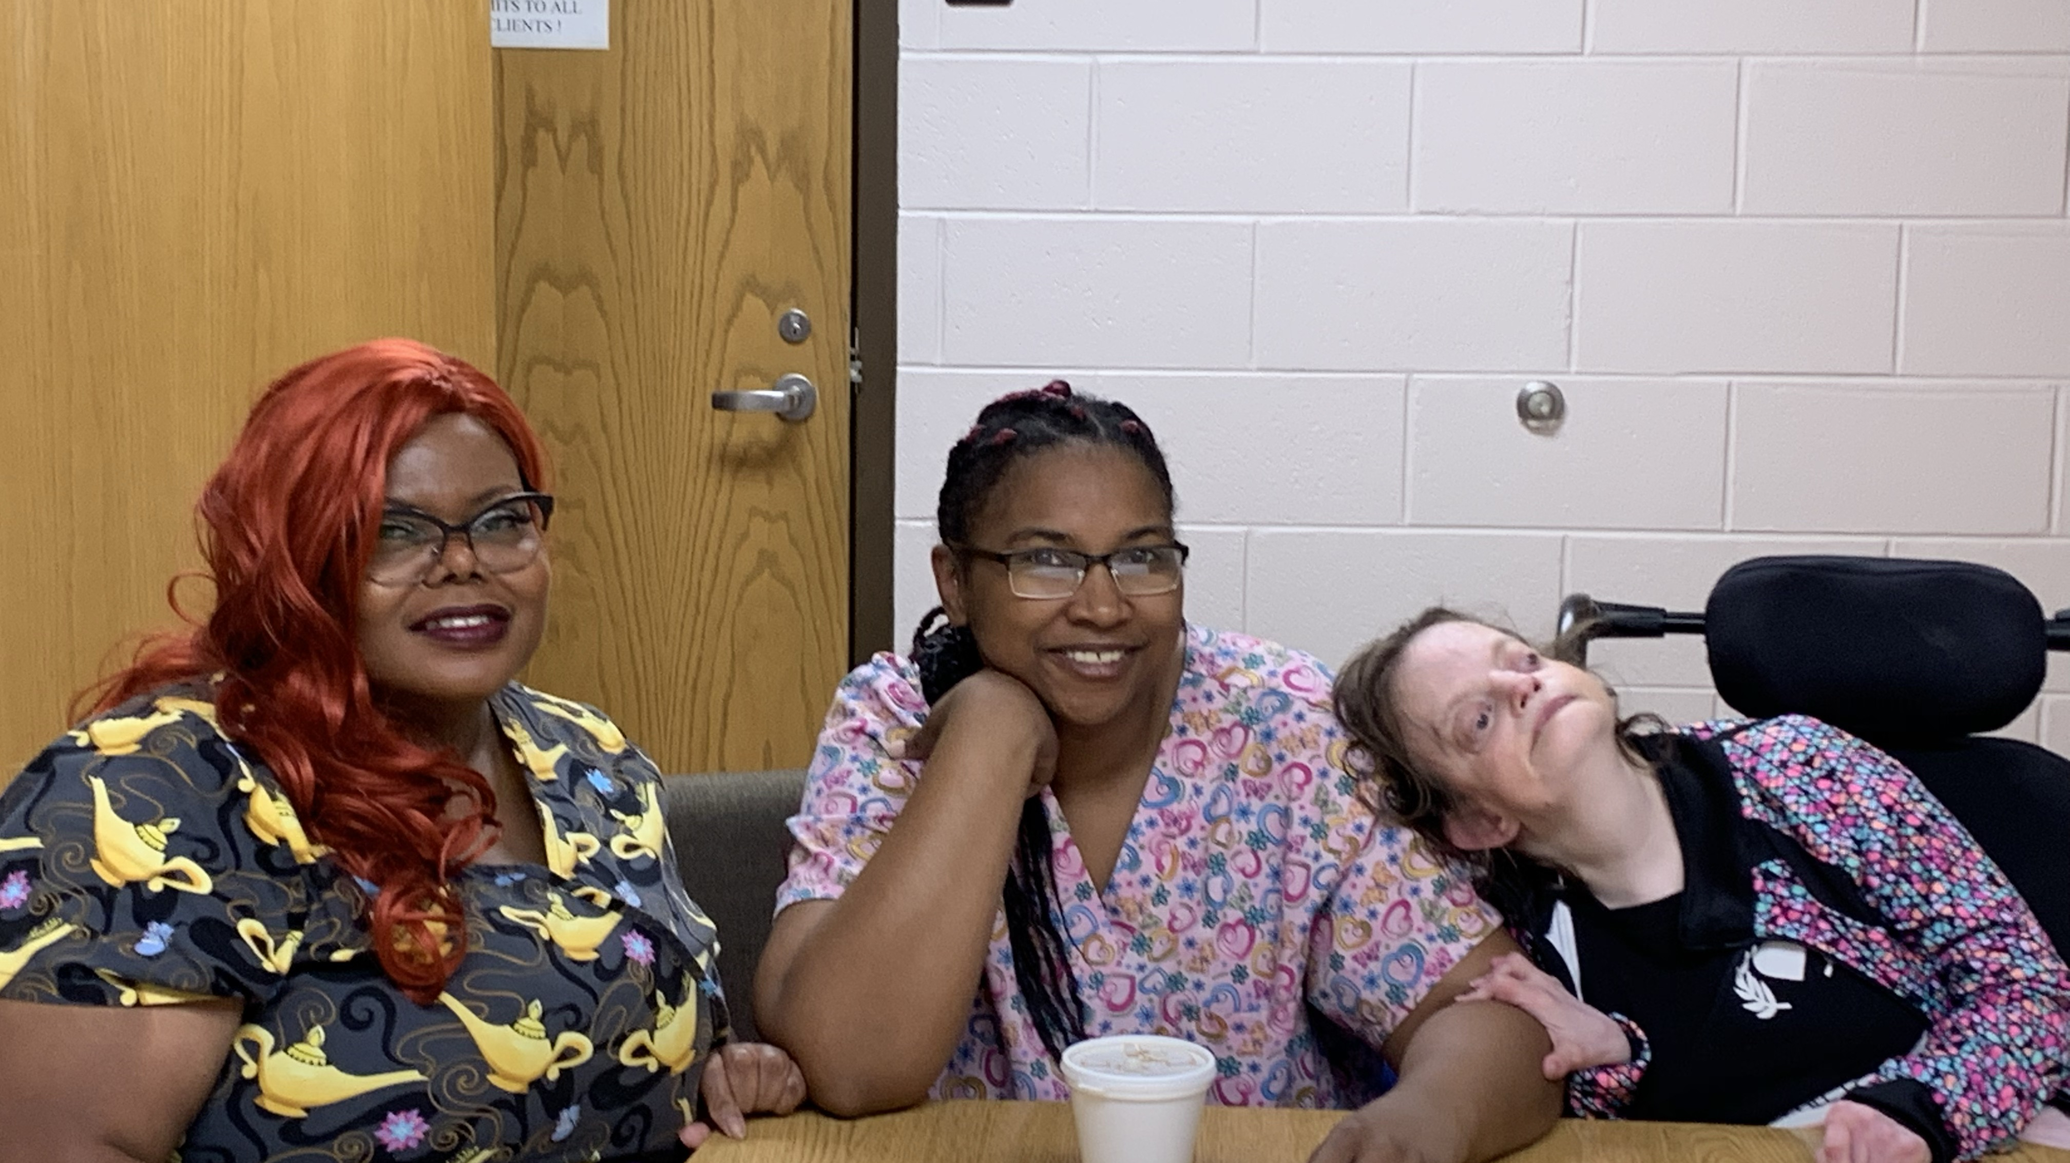

Slide 16
Next Steps into Year 3
Ongoing Network Development Support and Mentoring to Personal Network Teams
Explore options for improving access and sustainability across the state
Development of Specialized Training Guide using digital, print and video for sustainability
Evaluation using CQL outcomes to demonstrate results

Slide 17
Thank you to the NCCDD for funding this Initiative!

Slide 19
Contact www.firstwnc.org/fullcircle
Janet Price-Ferrell
janet@firstwnc.org
Rebecca Pauls
rpauls@plan.ca

