Slide 1
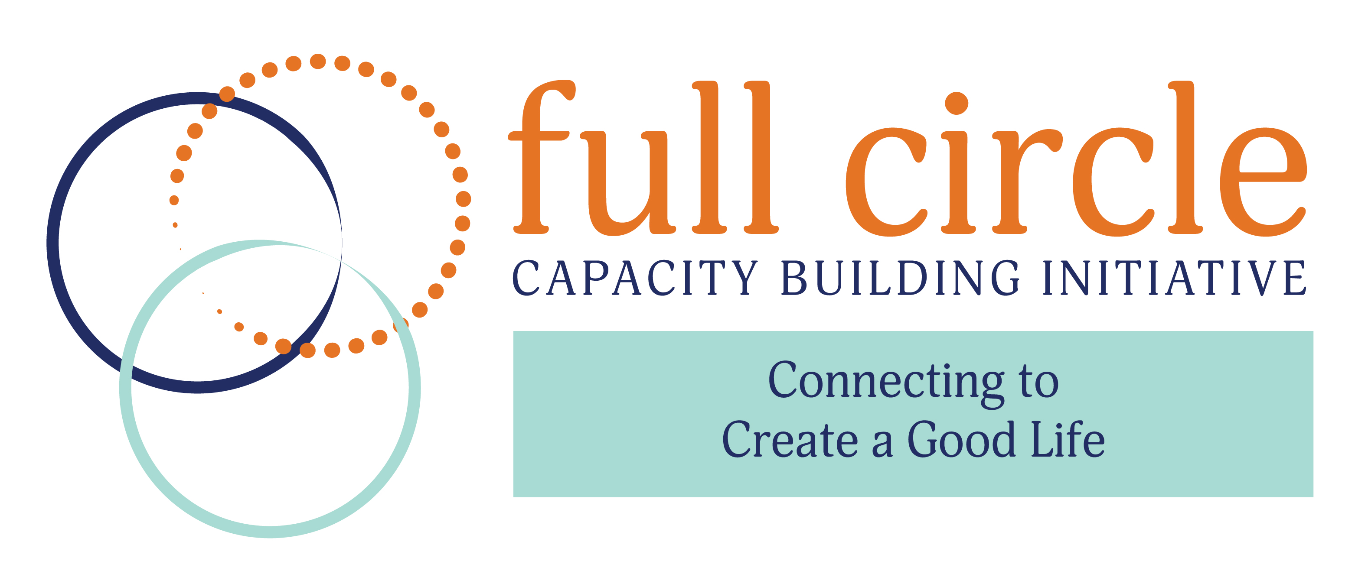

Slide 2
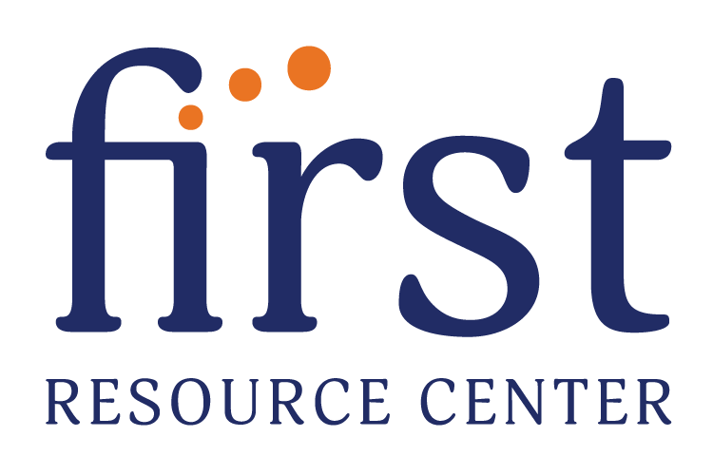

Collaborative Project Year 1 Report

Slide 3
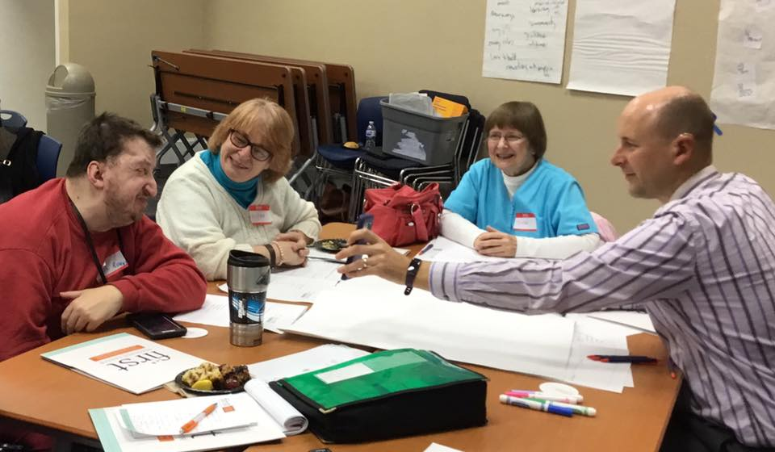
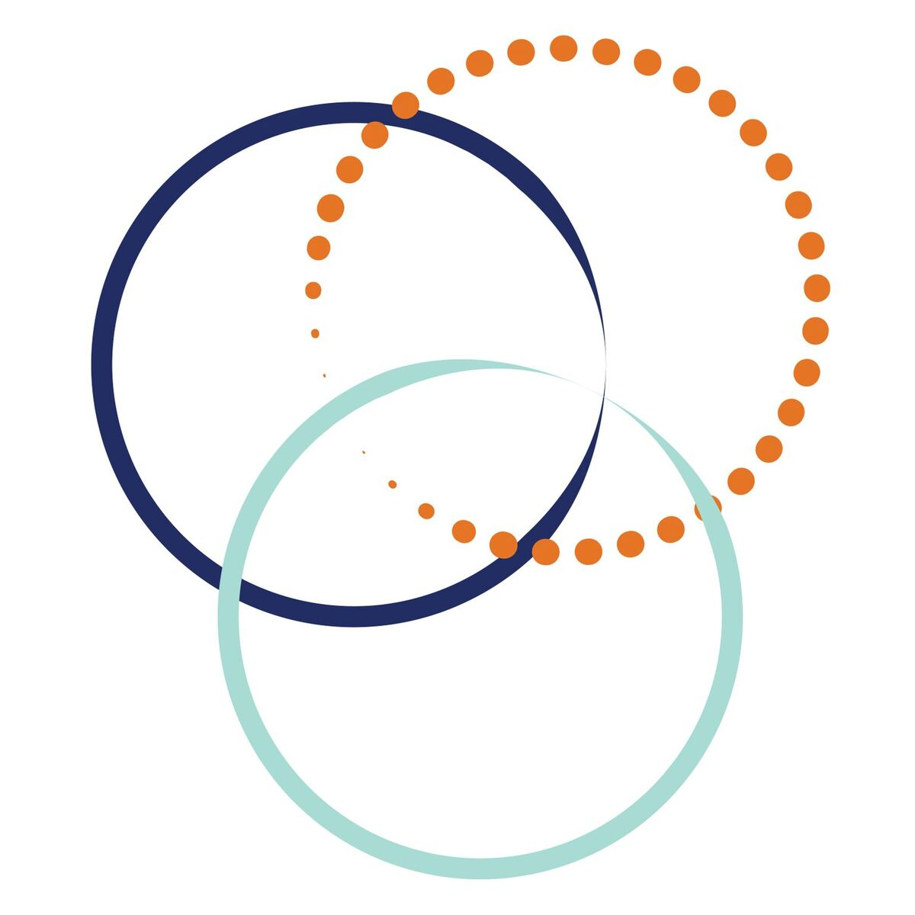
Full Circle is a capacity-building initiative designed to mobilize personal networks for people with disabilities.
Full Circle helps people to expand their circles of connection and natural support in their communities, giving them more opportunities for meaningful and supportive relationships, more experiences, an overall sense of belonging and a good, happy life.

Slide 4

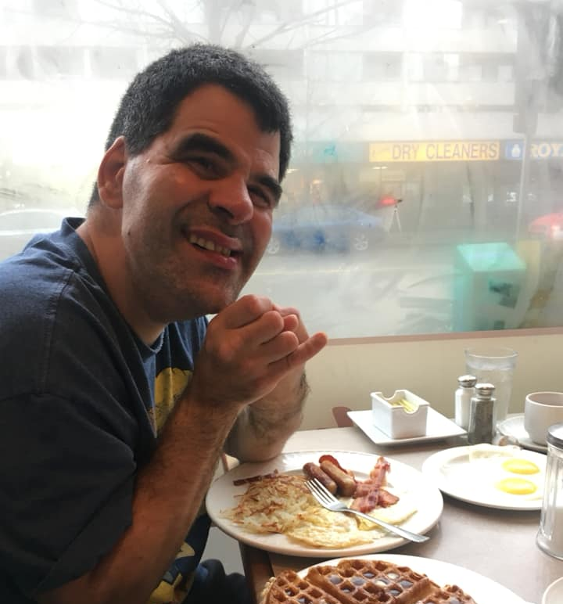
Full Circle’s program helps people with disabilities develop a Personal Network, which can do many things and serve many roles based on what the individual wants and needs, such as:
● Providing a sense of security and support for family members
● Providing links to others in the community
● Spending social time together
● Dreaming and planning together
● Securing and monitoring supports and services
● Assisting with finding homes and roommates
● Providing a forum for Network members to support one another

Slide 5
Full Circle will create a growing, scalable network of small teams that will help champion and implement their program, bringing happiness and more opportunities to people with disabilities throughout their communities.

Slide 6

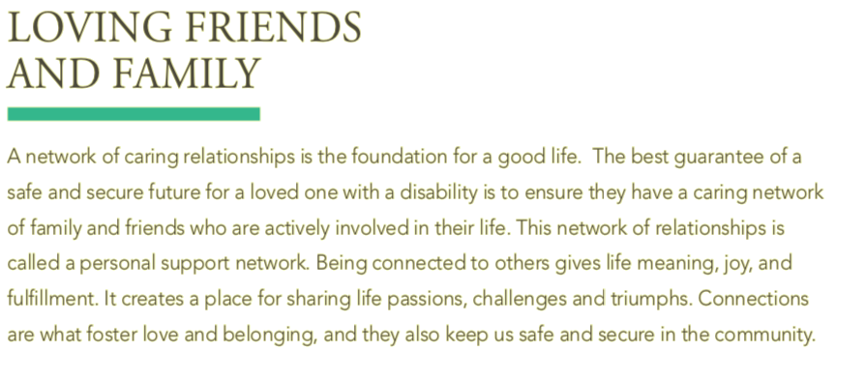

Slide 7
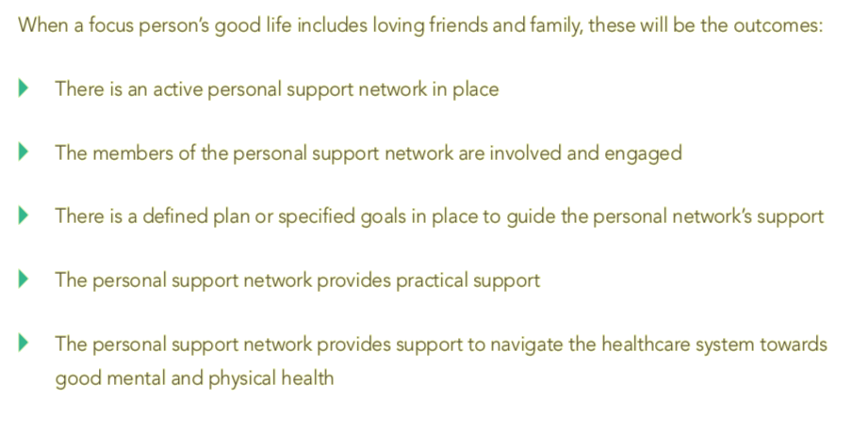

Slide 8
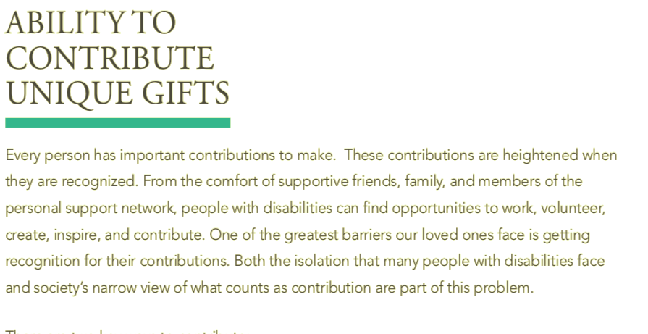

Slide 9
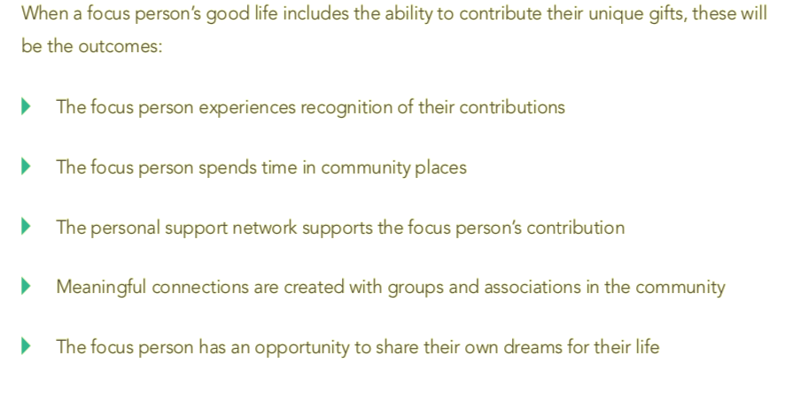

Slide 10
Working together with Planned Lifetime Advocacy Network and Plan Institute, over the next 24 months, Full Circle participants will:
Participate in 3 in-person/virtual workshops held in North Carolina
Complete an online course “Personal Support Network Facilitation”
Have access to tools and resource needed to develop a network
Receive ongoing Mentoring and Support
Provide updates and information will contribute to developmental learning and evaluation
Share stories and learning through social media

Slide 11
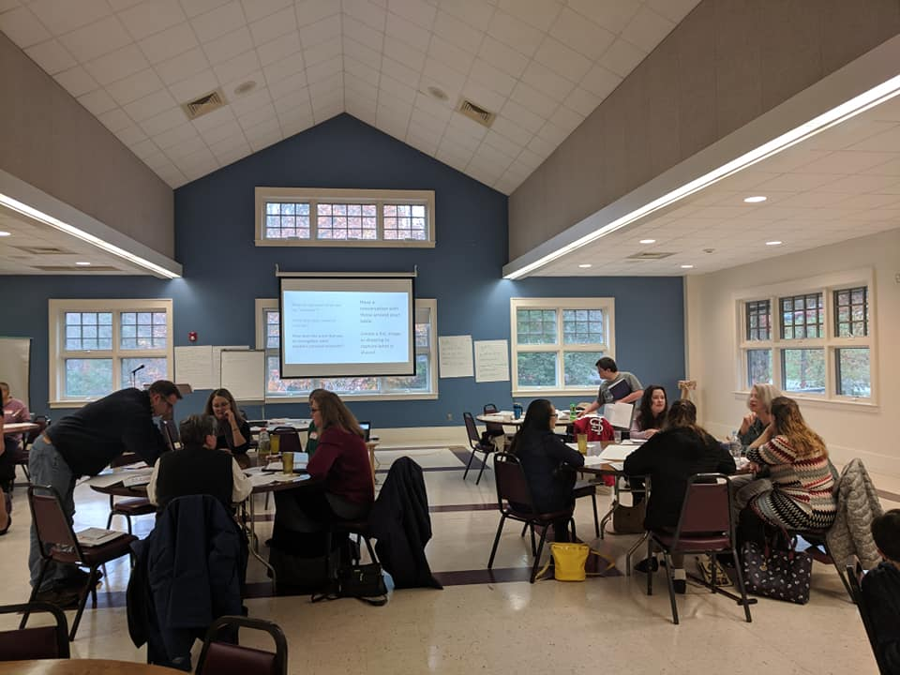
This will result in at least 25 success stories, and the 25 Network Facilitators will be able to repeat the process with more families and individuals with disabilities.
Full Circle will also develop a specialized Training Guide to be shared across North Carolina that would explain how natural supports can form, and the benefits of creating opportunities for natural supports to develop in the lives of individuals with disabilities.

Slide 12
“Every single person has capacities, abilities and gifts. Living a good life depends on whether those capacities can be used, abilities expressed and gifts given. If they are, the person will be valued, feel powerful and well-connected to the people around them. And the community around the person will be more powerful because of the contribution the person is making.”
- John McKnight, Asset-Based Community Development

Slide 13
Community Conversations
November 14th
Black Mountain
November 16th
Goldsboro

Slide 14
Data from Community Conversations
25% of the participants came from urban locations
75% from rural areas
64% represent work in professional roles within the disability sector
34% parents of a son or daughter who has a disability
14% Self Advocates
54% of the group of professionals were also parents or family members of a person with a disability

Slide 15
Products of YEAR 1
Webpage set up with updated information as project is ongoing
Facebook group created for reaching across the globe
Connections made with our groups around the world with same goals
Community Conversations held in community
Recordings of Community Conversations for ongoing use
Handbook created for particpants also to be part of the final product in YEAR 3

Slide 16
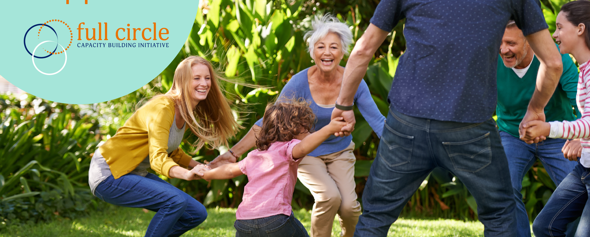
Thank you to the NCCDD for funding this Initiative!

Slide 17
Contact www.firstwnc.org/fullcircle
Janet Price-Ferrell
janet@firstwnc.org
Rebecca Pauls
rpauls@plan.ca

